Slide 1
4CP50: Python Programming
Chapter-7 Classes and Objects
Prepared By:
Dr. U. K. Jaliya,
Computer Engineering Department,
BVM.

Slide 2
Overview of OOP Terminology
Class: A user-defined prototype for an object that defines a set of attributes that characterize any object of the class. The attributes are data members (class variables and instance variables) and methods, accessed via dot notation.
Class or Static variable: A variable that is shared by all instances of a class. Class variables are defined within a class but outside any of the class's methods. Class variables are not used as frequently as instance variables are.
Data member: A class variable or instance variable that holds data associated with a class and its objects.
Function overloading: The assignment of more than one behavior to a particular function. The operation performed varies by the types of objects or arguments involved.

Slide 3
Cont…
Instance variable: A variable that is defined inside a method and belongs only to the current instance of a class.
Inheritance: The transfer of the characteristics of a class to other classes that are derived from it.
Instance: An individual object of a certain class. An object obj that belongs to a class Circle, for example, is an instance of the class Circle.
Instantiation: The creation of an instance of a class.
Method : A special kind of function that is defined in a class definition.
Object: A unique instance of a data structure that is defined by its class. An object comprises both data members (class variables and instance variables) and methods.

Slide 4
Creating Classes
The class statement creates a new class definition. The name of the class immediately follows the keyword class followed by a colon as follows:
The class has a documentation string, which can be accessed via ClassName.__doc__.
The class_suite consists of all the component statements defining class members, data attributes and functions.

Slide 5
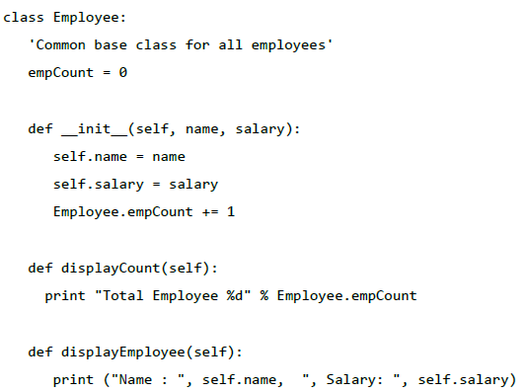
Example

Slide 6
Cont…
The variable empCount is a class variable whose value is shared among all the instances of a in this class. This can be accessed as Employee.empCount from inside the class or outside the class.
The first method __init__() is a special method, which is called class constructor or initialization method that Python calls when you create a new instance of this class.
You declare other class methods like normal functions with the exception that the first argument to each method is self. Python adds the self argument to the list for you; you do not need to include it when you call the methods.

Slide 7
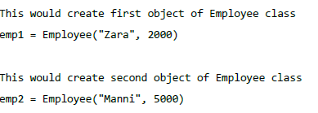
Creating Instance Objects
To create instances of a class, you call the class using class name and pass in whatever arguments its __init__ method accepts.

Slide 8

Accessing Attributes
You access the object's attributes using the dot operator with object. Class variable would be accessed using class name as follows:

Slide 9
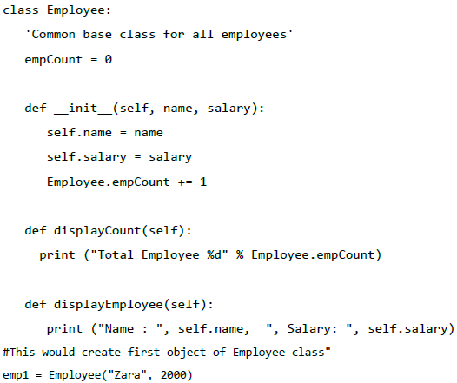
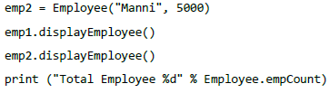
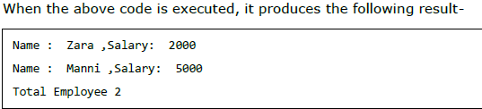
Entire Program

Slide 10

Cont…
You can add, remove, or modify attributes of classes and objects at any time:

Slide 11
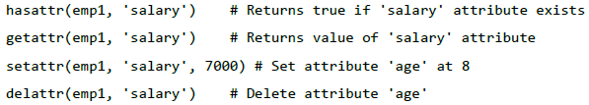
Functions for class attributes
The getattr(obj, name[, default]): to access the attribute of object.
The hasattr(obj,name): to check if an attribute exists or not.
The setattr(obj,name,value): to set an attribute. If attribute does not exist, then it would be created.
The delattr(obj, name): to delete an attribute.

Slide 12
Built-In Class Attributes
Every Python class keeps the following built-in attributes and they can be accessed using dot operator like any other attribute:
__dict__: Dictionary containing the class's namespace.
__doc__: Class documentation string or none, if undefined.
__name__: Class name.
__module__: Module name in which the class is defined. This attribute is "__main__" in interactive mode.
__bases__: A possibly empty tuple containing the base classes, in the order of their occurrence in the base class list.

Slide 13
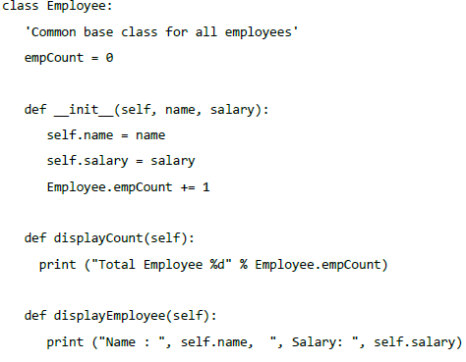
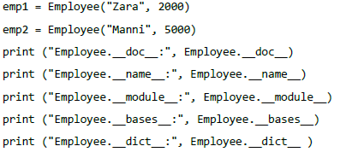
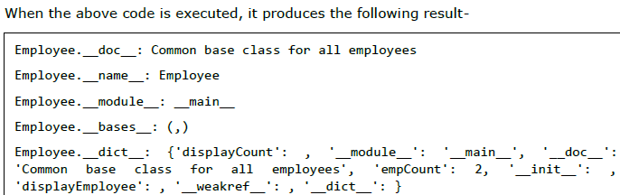
Example

Slide 14
Destroying Objects (Garbage Collection)
Python deletes unneeded objects (built-in types or class instances) automatically to free the memory space. The process by which Python periodically reclaims blocks of memory that no longer are in use is termed as Garbage Collection.
Python's garbage collector runs during program execution and is triggered when an object's reference count reaches zero. An object's reference count changes as the number of aliases that point to it changes.
An object's reference count increases when it is assigned a new name or placed in a container (list, tuple, or dictionary). The object's reference count decreases when it is deleted with del, its reference is reassigned, or its reference goes out of scope. When an object's reference count reaches zero, Python collects it automatically.

Slide 15
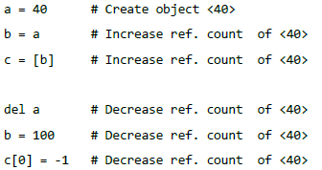
Cont…
You normally will not notice when the garbage collector destroys an orphaned instance and reclaims its space. However, a class can implement the special method __del__(), called a destructor, that is invoked when the instance is about to be destroyed. This method might be used to clean up any non-memory resources used by an instance.

Slide 16
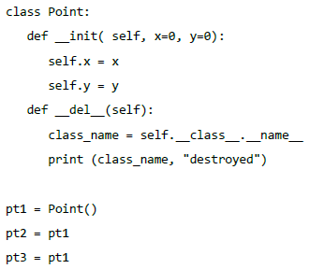


Example

Slide 17
Cont…
In the above example, assuming definition of a Point class is contained in point.py and there is no other executable code in it.
import point
p1=point.Point()

Slide 18
Inheritance
Inheritance is the process through which we can create new class from the existing class.
The existing class is called a base class or parent class and new class is called a derived class or child class.
The child class or derived class can inherit the feature of the base class and add its own features but reverse is not true.
It is the example of the reusability of the code.

Slide 19
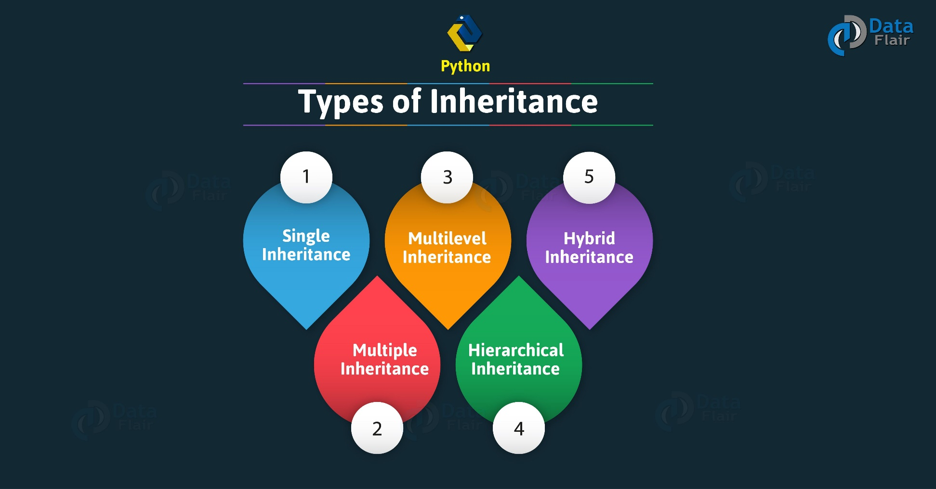
Types of inheritance

Slide 20

Class Inheritance
Derived classes are declared much like their parent class; however, a list of base classes to inherit from is given after the class name:

Slide 21

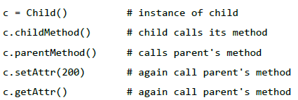
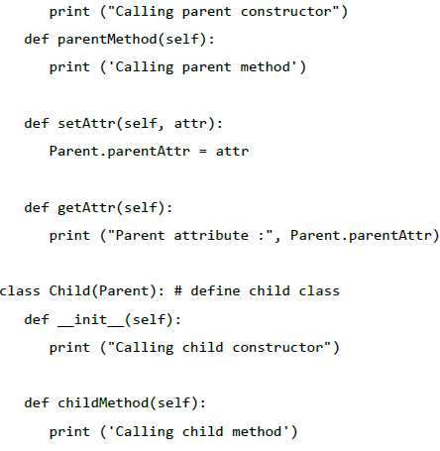
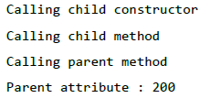
Example
output

Slide 22
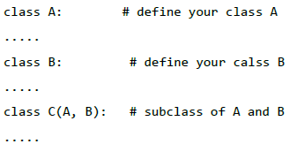
Cont…
In a similar way, you can derive a class from multiple parent classes as follows:

Slide 23
Cont…
You can use issubclass() or isinstance() functions to check a relationship of two classes and instances.
The issubclass(sub, sup) boolean function returns True, if the given subclass sub is indeed a subclass of the superclass sup.
The isinstance(obj, Class) boolean function returns True, if obj is an instance of class Class or is an instance of a subclass of Class.

Slide 24
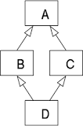
MRO in multiple inheritance
Method Resolution Order(MRO) it denotes the way a programming language resolves a method or attribute.

Slide 25
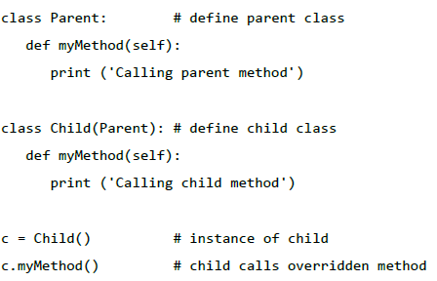
Overriding Methods
You can always override your parent class methods. One reason for overriding parent's methods is that you may want special or different functionality in your subclass.

Slide 26
Super() method
The Python super() function returns objects represented in the parent’s class and enables multiple inheritances.
class Parent: # define parent class
def myMethod(self):
print ('Calling parent method')
class Child(Parent): # define child class
def myMethod(self):
super().myMethod()
print ('Calling child method')
c = Child() # instance of child
c.myMethod() # child calls overridden method

Slide 27
Overloading Operators
Operator Overloading means giving extended meaning beyond their predefined operational meaning.
+ | __add__(self, other)
– | __sub__(self, other)
* | __mul__(self, other)
/ | __truediv__(self, other)
// | __floordiv__(self, other)
% | __mod__(self, other)
** | __pow__(self, other)
< | __lt__(self, other)
> | __gt__(self, other)
<= | __le__(self, other)
>= | __ge__(self, other)
== | __eq__(self, other)
!= | __ne__(self, other)

Slide 28
Example
class A:
def __init__(self, a):
self.a = a
# adding two objects
def __add__(self, o):
return self.a + o.a
ob1 = A(1)
ob2 = A(2)
ob3 = A(“BVM")
ob4 = A(“CP")
print(ob1 + ob2)
print(ob3 + ob4)

Slide 29
Example
class A:
def __init__(self, a):
self.a = a
def __gt__(self, other):
if(self.a>other.a):
return True
else:
return False
ob1 = A(2)
ob2 = A(3)
if(ob1>ob2):
print("ob1 is greater than ob2")
else:
print("ob2 is greater than ob1")

Slide 30
Data Hiding
An object's attributes may or may not be visible outside the class definition.
You need to name attributes with a double underscore prefix, and those attributes then will not be directly visible to outsiders.

Slide 31
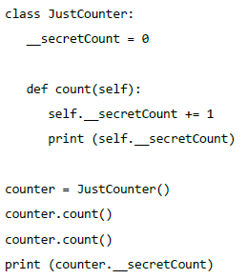
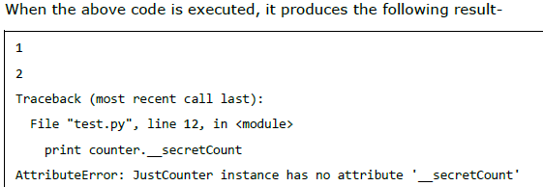
Example
Python protects those members by internally changing the name to include the class name. You can access such attributes as object._className__attrName. If you would replace your last line as following, then it works for you-
print (counter._JustCounter__secretCount)

Slide 32
Instance, Static and Class methods
class ExampleClass(object):
def some_method(self):
pass
@classmethod
def class_method(cls):
pass
@staticmethod
def static_method():
pass

Slide 33
Cont…
In above example, some_method() is called the object method or instance method. The method takes one paramater self, which points to an instance of class ExampleClass when the method is called.
Class methods in Python can be defined by assigning @classmethod to any method. The thing to note here is that the class methods take cls parameter that points to a class and not the instance of the class.
Like any function that we call, static methods can be called in a similar way. Hence, static methods are like regular functions just with the fact that they belong to a class’s namespace.
Static methods can be defined by decorating methods with @staticmethod decorator.

Slide 34
Abstract Class and abstract method
In object-oriented programming, an abstract class is a class that cannot be instantiated. However, you can create classes that inherit from an abstract class.
Typically, you use an abstract class to create a blueprint for other classes.
Abstract method is an method without an implementation. An abstract class may or may not include abstract methods.
Python doesn’t directly support abstract classes. But it does offer a module that allows you to define abstract classes.
To define an abstract class, you use the abc (abstract base class) module.
Abstract class methods are created using the @abstractmethod decorator.

Slide 35
Cont…
from abc import ABC
class AbstractClassName(ABC):
pass
from abc import ABC, abstractmethod
class AbstractClassName(ABC):
@abstractmethod
def abstract_method_name(self):
pass

Slide 36
Example
from abc import ABC, abstractmethod
class Car(ABC):
def mileage(self):
pass
class Tesla(Car):
def mileage(self):
print("The mileage is 30kmph")
class Suzuki(Car):
def mileage(self):
print("The mileage is 25kmph ")
t= Tesla ()
t.mileage()
s = Suzuki()
s.mileage()

Slide 37
Try to find the output
class mySecondClass:
a,b,c=0,"Rao",(1,2)
pass
A=mySecondClass()
print(A.a, A.b, A.c)

Slide 38
Output
0 Rao (1, 2)

Slide 39
Try to find the output
class mySecondClass:
a,b,c=0,"Rao",(1,2)
pass
A=mySecondClass()
print(A.a, A.b, A.c)
B=mySecondClass()
print(B.a, B.b, B.c)
print(id(A.a), id(B.a))
print(id(A), id(B))
A.a+=10
print(A.a, B.a)
print(id(A.a), id(B.a))

Slide 40
Output
0 Rao (1, 2)
0 Rao (1, 2)
1653171280 1653171280
62415312 64903792
10 0
1653171440 1653171280

Slide 41
Try to find the output
class XYZ:
def __init__(self,n):
self.objectNo=n
def show(self):
print(self.objectNo)
A=XYZ(10)
ashow=A.show
B=XYZ(20)
ashow()
C=XYZ(100)
C.show()

Slide 42
Output
10
100

Slide 43
Z=10
class XYZ:
def __init__(self):
global Z
Z=29
print(Z)
def test(self):
print(Z)
class PQR:
def __init__(self):
print(Z)
A=XYZ()
A.test()
B=PQR()

Slide 44
output
29
29
29

Slide 45
Find output
class A:
var=1
def __init__(self):
print (self.var, A.var)
self.__class__.var+=2
print (self.var, A.var)
A.var+=2
print (self.var, A.var)
self.var+=2
print (self.var, A.var)
print ("\n")
def show(self):
print (self.var, A.var)
x=A()
x.show()
print ("\n")
y=A()
y.show()
x.show()

Slide 46
Output
5 5
7 7
9 9
11 9
11 9
7 9
1 1
3 3
5 5
7 5
7 5

Slide 47
Find output
a = A()
a.var = 2
a.printvar()
print ("\n")
A.var = 3
a.printvar()
b=A()
print ("\n")
b.printvar()
print ("\n")
A.MyStaticMethod()
b.printvar()
class A:
var=1
def printvar(self):
self.abc()
print ("self.x=%d" % self.x)
print ("self.var is %d" % self.var)
print ("A.var is %d" % A.var)
def abc(self):
self.x=A.var
A.var+=1
@staticmethod
def MyStaticMethod():
A.var+=1

Slide 48
Output
self.x=1
self.var is 2
A.var is 2
self.x=3
self.var is 2
A.var is 4
self.x=4
self.var is 5
A.var is 5
self.x=6
self.var is 7
A.var is 7

Slide 49
Thank You

